Slide 1
Ally Skills Workshop
Using Your Societal Advantages for Good
Presented by Kendra Albert
Format pioneered by and licensed CC-BY, Valerie Aurora, Frameshift Consulting.
All added material licensed CC-BY 2.0, Kendra Albert.

Slide 2
Who am I?
Out non-binary person (they/them please!).
“Day job” as a technology lawyer
Trans and feminist activist

Slide 3
Agenda for today:
What is an ally and why ally skills?
Terminology, discussion guidelines and dos and don’ts
Ally skills scenarios
Break
More scenarios
Wrap-up and general tips
Notes:
Thanks to everyone for coming today.

Slide 4
Help us create a safer space
You may leave or return at any time, for any reason, without explanation.
This workshop is not recorded.
Everyone is here voluntarily.
Please anonymize when you repeat sensitive stories.
Share at the level of people you just met at a conference.

Slide 5
What is an ally and why should you practice ally skills?

Slide 6
What is an ally? Some terminology first:
Privilege: an unearned advantage given by society to some people but not all
Oppression: systemic, pervasive inequality that is present throughout society, that benefits people with more privilege and harms those with fewer privileges

Slide 7
Categories of privilege:
White Male Cisgender (more later) Straight Not disabled A legal resident or citizen Specific ages Certain height/size/shape | Not a mother (sometimes) Not a caregiver Educated Technically experienced Wealthy (can be earned) From an upper class family And many more...
Notes:
Don't read the obvious ones, just the ones that are more relevant or less obvious.
Note that some of these are situational – sometimes motherhood is privileged, sometimes it isn’t, etc.

Slide 8
What is an ally? Some terminology first:
Target: someone who suffers from oppression (also called "a member of a marginalized group")
Ally: a member of a (privileged) social group that is working to end oppression and understand their own privilege
Actions

Slide 9
Example
Privilege: The ability to walk into a convenience store and have the owner assume you are there to buy things and not steal them
Oppression: The self-reinforcing system of stories, TV, news coverage, and legal system stereotyping Black people as criminals, that benefits non-Black people and harms Black people
Notes:
Let’s do a quick example. Here’s an example of a privilege some of you may not even realize you have. (Read slide) Note how the ally is defined by their actions.

Slide 10
Example
Target: any Black person who wants to enter a convenience store
Ally: a non-Black person who, e.g.,:
does not shop at stores that they know profile Black people,
actively objects to racist stories,
votes in anti-racist ways,
and reads news articles about this privilege.
Notes:
Let’s do a quick example. Here’s an example of a privilege some of you may not even realize you have. (Read slide) Note how the ally is defined by their actions.

Slide 11
Why should allies take action?
"[...] Ethnic minority or female leaders who engage in diversity-valuing behavior are penalized with worse performance ratings; whereas [ethnic majority] or male leaders who engage in diversity-valuing behavior are not penalized for doing so."
David Hekman, Stefanie Johnson, Wei Yang & Maw Der Foo, Does valuing diversity result in worse performance ratings for minority and female leaders?, http://amj.aom.org/content/early/2016/03/03/amj.2014.0538.abstract (2016).
Notes:
Targets are more likely to suffer retaliation when they speak out against oppression. This great study from 2014 looked at what happened to men vs. women and people of color vs white people when they did what they called "engage in diversity-valuing behavior." Listen to this quote: (Read slide)

Slide 12

Also…
Allies may be in the majority.
Allies may face less blowback.
Allies are often less likely to be put in physical danger.
CC BY Nick https://flic.kr/p/5bt6cp

Slide 13
Terminology and
Discussion Guidelines:

Slide 14
Terminology for gender
Cis: your gender is the same as the gender that was assigned to you at birth
Trans: your gender is different than the gender that was assigned to you at birth
Non-binary or genderqueer or agender: "male" or "female" doesn't describe your gender accurately, or you don’t identify with a gender at all

Slide 15
Terminology for gender
Use they instead of "he" for third person singular pronoun of unknown gender.
Terms for groups of people of particular genders: men for cis and trans men, women for cis and trans women, non-binary people/folks, cis men, trans men, cis women, trans women, people of all genders, folks, people, everyone, all, y'all, all y'all...

Slide 16
Please don’t use:
Girls for women 18 years of age and over.
Guys for groups that are not all men (say "everyone" or "people").
Ladies - associated with "proper" (i.e., subservient) behavior.
Females for humans - used for animals and plants too, so it is dehumanizing.
Notes:
http://i.imgur.com/0YoRYLK.jpg

Slide 17
Please don’t use:
Transsexual - not inclusive of all trans people
People with [BODY PART or CHROMOSOME] instead of "men" or "women"
Exception: members of any marginalized group can agree to call themselves whatever they want (outsiders should not assume they can use the same terms)

Slide 18
Pronoun and transition dos and don’ts:
Do: check in if you’re unsure about pronoun use or how to navigate a transition. To be clear, a person’s personal wishes override this list or any other advice.
Do: assume retroactivity unless told otherwise.
Do: use current preferred pronouns for famous trans people (like Chelsea Manning).
Absolutely don’t: ask about transition logistics or surgery.
Absolutely don’t: out the person.*
*Unless they’re already publically out or you’ve been given express permission.

Slide 19
Microaggressions: gender
Office housework being assigned primarily to women and femme folks
Telling femme folks and women to smile
Praising a woman’s appearance in a professional context
Critiquing vocal fry or uptalk (when feedback is not requested)
Asking trans people about their body parts or assigned at birth sex
Notes:
What are microaggressions? Microaggressions are small actions or comments that may not be intended to be hurtful but cumulatively remind targets of their status/oppression. Even though many of us work our hardest not to be consciously biased, noticing and eliminating microaggressions is a vital part of an ally practice.
https://wotc.crn.com/blog/a-micro-list-of-microaggressions-against-women-in-the-workplace
Microaggressions and traumatic stress (http://www.apa.org/pubs/books/4317475.aspx)

Slide 20
Terminology for sexuality
Straight: women attracted primarily to men or men attracted primarily to women
Gay: men or women attracted primarily to people of the same gender as themselves
Lesbian: women attracted primarily to women

Slide 21
Terminology for sexuality
Bisexual or pansexual: people attracted to people of any gender (debate on-going)
Asexual: people with little or no sexual attraction to people of any gender
Queer: a useful catch-all term for people who don't fit easily into "straight cis woman" or "straight cis man"
Notes:
Usage of queer has changed over time

Slide 22
Microaggressions: sexuality
Assuming that a person’s partner is a different gender
Assuming because a person’s partner is a different gender, that they are straight
Calling a queer person’s partner their “friend”
Calling a person’s sexuality a phase
“I know another gay person!”
Notes:
Presumed immigrant status
Presumption that folks of color
https://wotc.crn.com/blog/a-micro-list-of-microaggressions-against-women-in-the-workplace
Microaggressions and traumatic stress (http://www.apa.org/pubs/books/4317475.aspx)

Slide 23
Discussing race and ethnic groups:
Use the term(s) for each ethnic group or race that the majority of that group prefers that outsiders use.
Avoid abbreviations, just say or write the full name.
Don’t make generalizations about food, jobs, religion, citizenship, immigration status, languages, hobbies, etc. based on race.
Distinguish between citizenship and descent.
Notes:
https://commons.wikimedia.org/wiki/File%3ADog_ultrasound_whistle_ID_tag.jpg

Slide 24
Commonly used terms for race:
People of color, white
Black, Latina/Latino/Latinx, Asian, Asian & Pacific Islander (API), south Asian, east Asian.
Native Americans for indigenous peoples of mainland U.S.
First Nations for indigenous peoples of Canada
Native Hawaiians for indigenous peoples of Hawaii
Alaskan Natives for indigenous peoples of Alaska
Notes:
North America specific. Distinguish from nationality or descent. (Someone’s race is Asian, their parents may be from Japan and are Japanese citizens, etc.)

Slide 25
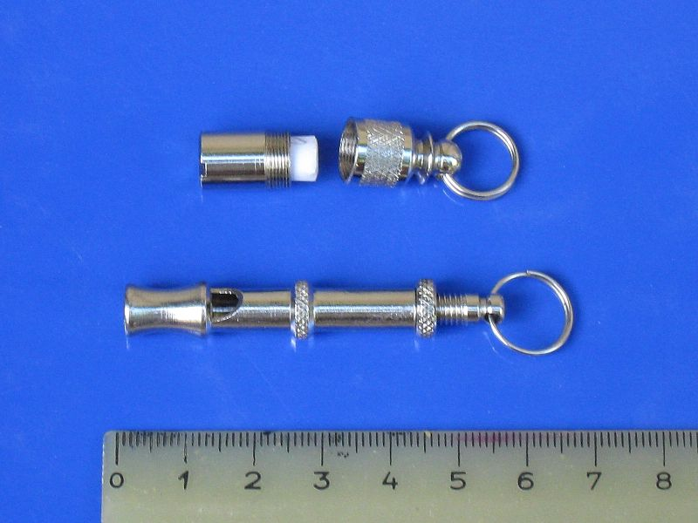
Discussing race:
Dog whistles: dogs can hear them but people can't
Don't use "dog whistle" terms to refer to an ethnic group indirectly - e.g., "ethnic" or "urban"
If uncertain about term to use to refer to a specific ethnic group, ask!
CC BY-SA Turbojet on Wikimedia Commons
Notes:
https://commons.wikimedia.org/wiki/File%3ADog_ultrasound_whistle_ID_tag.jpg
For clarity (I personally run into this a lot and find this point useful in discussions about racism): Racism is NOT generally talking about race (not in a derogatory way) or describing someone’s race.

Slide 26
Microaggressions: race and ethnicity
Asking ”where are you from?”
Showing off language skills from a specific country after asking where someone is from
Calling a person of color, specifically Black people, “articulate”
“I have [race] friends.”
“I don’t see color.”
Comments about affirmative action or diversity hires
Notes:
Presumed immigrant status
Assuming that because of someone’s race, or ethnicity that
Presumption that folks of color are not articulate, that such a fact is surprising
I am immune to races because I have friends of color.
Denying a person of color’s racial / ethnic experiences.
Assuming that someone is not as qualified because of their race
For more: http://sph.umn.edu/site/docs/hewg/microaggressions.pdf

Slide 27
Terminology for disability
Use abled person or non-disabled person, disabled person, or person with disabilities.
Only use respectfully in cases of self-disclosure: ADD/ADHD, OCD, autism spectrum, schizophrenic, bipolar...
Don’t use terms as nouns: an autistic, an epileptic.
Don’t use euphemisms or judgmental terms: “special needs, “differently able,” “mentally challenged,” “wheelchair bound,” “suffers from…,” “victim of…”
Notes:
http://disabilityinkidlit.com/2016/07/08/introduction-to-disability-terminology/

Slide 28
Discussing disability
Don’t use names of specific disabilities as metaphors or similes to indicate badness (deaf, blind, etc.).
Don't use words historically associated with diagnosis: lame, dumb, stupid, crazy, retard, etc. Instead use "foolish," "thoughtless," or "inconsiderate.” Or a specific adjective like "crowded," "disorganized," or "annoying."
It’s generally fine to use figures of speech like "see what I mean" or "I hear you.”

Slide 29
Discussing religion, class, age, etc.
Speak respectfully about religious or spiritual beliefs (but you don't need to be respectful of bigotry or intolerance).
Do not conflate religion and race. For example, Judaism and Islam are religions, not races.
Don’t use stereotypes about people with lower class jobs (e.g. janitor), adults of particular ages, family role (mother, grandparent, etc.)
Treat caregivers of all sorts respectfully, including mothers.

Slide 30
What if I make a mistake?
Apologize, correct yourself, and move on.
Notes:
Mistakes in both life and in this workshop.

Slide 31
Awkward...

Slide 32

CC BY Andrew Kuznetzov https://flic.kr/p/4c8Sax

Slide 33
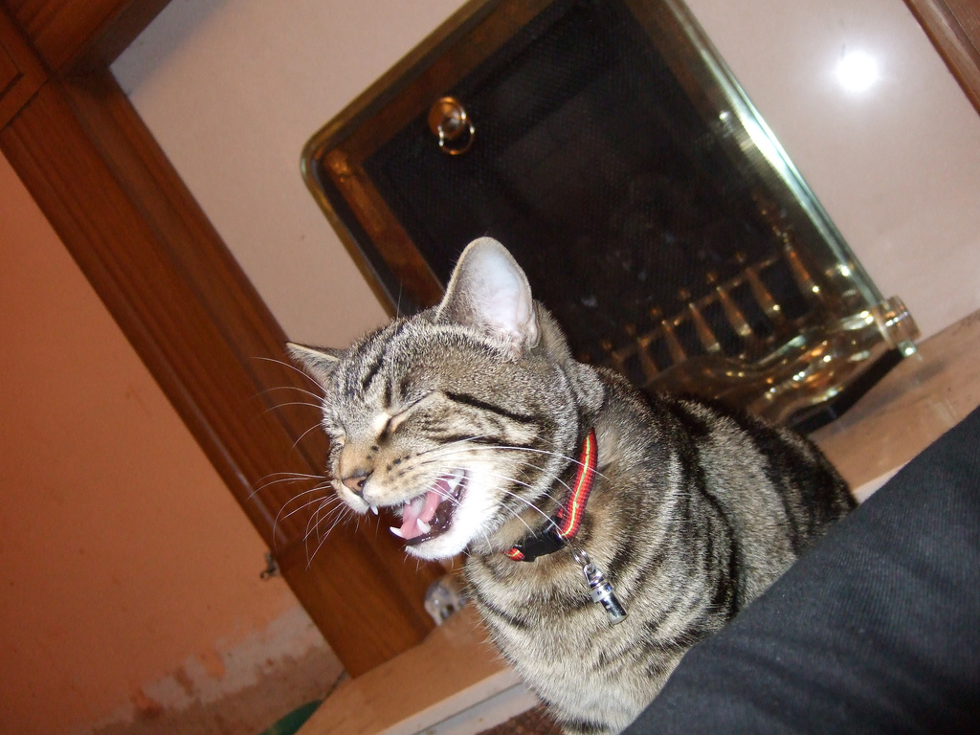
CC BY John of Wales https://flic.kr/p/HaeRd

Slide 34
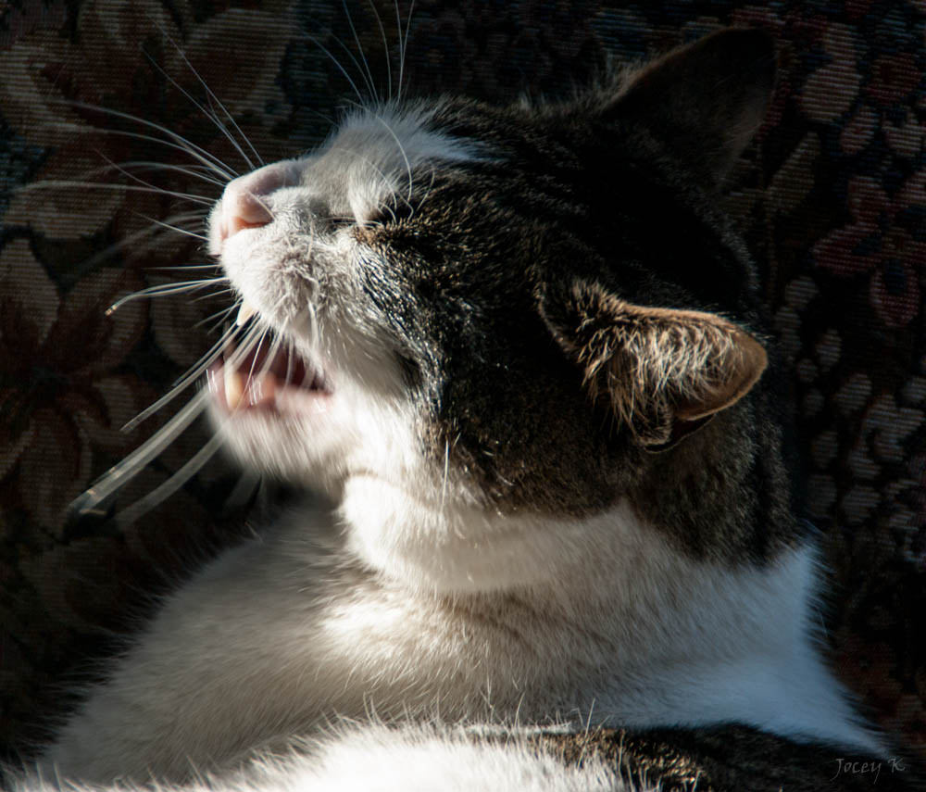
CC BY-SA Jocelyn Kinghorn https://flic.kr/p/jXHrXR

Slide 35
Content warnings
The scenarios contain discussions of: racism, Islamophobia, and street harassment.
Note: neither the scenarios nor I will use specific slurs, but some may use uncomfortable language.
Absolutely do not speculate about what language might be used or reproduce slurs in the context of your answers.

Slide 36
Practice Scenarios

Slide 37
DREADED GROUP CHOOSING TIME
Form groups of 4 - 6 people.
Groups that are more diverse have better discussions.
Introduce yourselves BRIEFLY (1-3 sentences) and include your pronouns.
At the breaks, please volunteer to change groups.

Slide 38
Preparing for group discussion
If everyone in the group has the same pronouns, tell the instructor.
Choose a gatekeeper to interrupt people who are speaking too much and ask people who aren't talking as much if they want to speak.

Slide 39
A few more tips for group discussion
At the beginning of each scenario, choose someone to report out at the end (this person can change)
Avoid rules-lawyering: "But what if there was some specific highly unlikely circumstance in which this situation was not actually bad?"
Focus on how to respond to incidents as an ally in this specific incident, not as the target or in the general case

Slide 40
Basics of ally skills
Be short, simple, firm.
Don't try to be funny.
Play for the audience.
Practice simple responses.
Pick your battles.
Notes:
How to choose what battles to pick – am I the person in this situation who will face the least blowback?

Slide 41
Most importantly, don't be:
sexist,
homophobic,
transphobic,
racist,
ableist,
classist,
ageist, and don't make fun of people for being sexually undesirable, unattractive, etc.

Slide 42
Scenario 1: unequal office housework
You notice an older male colleague of yours always asks your younger female colleague to grab coffee for visiting guests, take notes or otherwise do “office housework.” They are at the same level organizationally, although he has been working at your organization for longer.
Notes:
Goal response:
Noticing in the first step!
Check in with her to ask her if she would like you intervene. Offer to get the coffee or take notes since she did it last time. Come up with more equitable ways of allocating office housework responsibilities.

Slide 43
Things to pay attention to:
Who is speaking most in your group?
Is someone having difficulty being heard?
Are there patterns related to gender, race, age, or anything else?
How do these discussions compare to ones you have in other contexts?

Slide 44
Scenario 2: misgendering, deadnames, and emails
In an email thread, you refer to a trans woman colleague using her preferred name and pronouns (she/her/hers, in this case).
Another person replies using her previous name (a.k.a. “dead name”) and he/him/his pronouns to refer to her. She is not on the thread.
Notes:
Goal response: Reply directly to thread clarifying that her name is ”her name” and she uses she/her pronouns. Even if it’s totally accidental, correcting directly is important. If malicious, same first response, then escalate as necessary.
Someone in a workshop I ran once compared the appropriate tone to telling someone their fly was open.

Slide 45
Break Time

Slide 46
Scenario 3: an unhappy hour
In a small group conversation you’re in at a networking happy hour, a male authority figure makes a joke about how much sex another male authority figure must have had in order to have so many children.
Everyone is holding an alcoholic drink.
Notes:
Goal response: “I do not want to speculate on [Dude]’s sex life.” or “What an inappropriate thing to say!” or “Wow.” or walk away.
Makes an assumption that the dude in question is straight/cis.

Slide 47
…what’s wrong with jokes about sex?
Double standard for straight sex and gay sex
Double standard for sex for men and women
"Family size" talk can be racism & religious discrimination
Fertility, pregnancy, adoption can be highly emotional
Assumes parents are cis and straight

Slide 48
who makes it awkward?
Responders often worry about ”making it awkward,” “upsetting people,” or “causing drama.”
The person who made the problematic comment made it awkward.
“Appalled silence is too easily mistaken for assent.” – Jennifer Peepas
Notes:
You will probably get questions of the form mentioned in this slide.
Reframe this kind of question as, “Someone is already upset: you, and anyone else this behavior is harming.” Often the problem is we value the feelings of the more powerful person than multiple less powerful people.
Discuss the risks of speaking up in this situation. If the person doing the upsetting thing is in a position of power and can retaliate, that's a good reason not do anything. Sometimes people speak up anyway because they can't take the abuse any longer and that's okay too.

Slide 49
Scenario 4: that person on email
On a mailing list that you are required to be on professionally, someone writes “How would you explain this [technical thing] to your girlfriend?”
(using a woman as an example of a technically unsavvy person)
Notes:
Goal response: Reply publicly in a short comment describing the comment as sexist (describe the behavior as sexist instead of the person).
When should you reply privately? When it is someone who respects your opinion. Beware, some abusers prefer private communication to hide a pattern of abuse. In all cases, someone needs to respond to this publicly so others see what is expected.
Give them an easy out, “I know you didn't mean it this way but what you did was...”
When you make it clear what is not acceptable in the mailing list, it is really helpful to point to a (good) code of conduct. See http://geekfeminism.wikia.com/wiki/Code_of_conduct_evaluations.

Slide 50
Tip: Charles' Rules of Argument
Don't go looking for an argument.
State your position once, speaking to the audience.
Wait for absurd replies.
Reply one more time to correct any misunderstandings of your first statement.
Do not reply again.
Spend time doing something fun.
Notes:
No devil’s advocate!
Who is Charles? Charles Miller, a guy on the Internet who used to spend a lot of time in flame wars. Then he got better!
These aren't hard and fast rules and may not work for every case, but they apply pretty well to mailing lists, blogs, comments, and social media. In person, ending the conversation is usually more complicated than ceasing to speak and may require firm repeating of “I don't want to have this conversation right now,” or changing the subject.

Slide 51
Scenario 5: suspicious feedback
You are in the process of reviewing candidates for an executive position. Multiple people who are also a part of the review comment that the black female candidates seem too interested in their own personal gain. No other candidates get similar comments.
Notes:
Also, first off, note that this example calls out race, but others didn’t – if you imagined everyone else as white, that’s worth thinking about.
Point out that there seems to be this pattern. Explicitly call it out as applying to black women (not just women of color).
Suggest reading materials – such as “What Works for Women At Work” or the work of Robert W. Livingston, to better understand stereotypes that might be operating in both reviewers minds and your hiring process.
Develop a plan to combat racism and sexism that may operate within your community or workplace, including training. Come up with objective criteria to determine promotions.

Slide 52
understanding sexism as intersectional
“Black women can use a direct, assertive style, but not to act in ambitious, self-promoting, or power-seeking ways. Black women have license to be assertive in achieving the goals of the group—but not in seeking power for themselves.”
Joan C. Williams, Rachel Dempsey, What Works for Women at Work: Four Patterns Working Women Need to Know (2014), at 234.
Notes:
Sexism against black women specifically: “misogynoir” – Moya Bailey
http://www.gradientlair.com/post/84107309247/define-misogynoir-anti-black-misogyny-moya-bailey-coined

Slide 53
Wrap Up

Slide 54
What if I screw up?
Listen to the person.
Validate and apologize. (Apologies cost nothing.)
Don’t take it personally.
Look into how to do better.
If responding on behalf of an organization, emphasize concrete steps taken.
Notes:
Do not expect the person to educate you.
https://medium.com/@schmutzie/why-it-is-not-my-responsibility-as-a-marginalized-individual-to-educate-you-about-my-experience-915b4ec08efd#.52ssyk2w9

Slide 55
Next steps:
Don't expect praise and credit for fighting inequality. There are no “ally points.”
Follow and support leaders from target groups (monetarily).
Assume targets are knowledgeable about their oppression.
When you make a mistake, apologize, correct yourself, and move on.

Slide 56
This workshop is not a certification.
Don’t be Kool Aid Man.
Ally is a thing you do (sometimes), not a title that you are given.
We will all continue to make mistakes, what counts is how you react.

Slide 57
Resources – books:
Ijoema Oluo, So You Want to Talk About Race (2017).
Joan C. Williams, Rachel Dempsey, What Works for Women at Work: Four Patterns Working Women Need to Know (2014).
Allison Kafer, Feminist, Queer, Crip (2013).
The Responsible Communication Style Guide (2017).
Notes:
https://shop.recompilermag.com/collections/books/products/the-responsible-communication-style-guide?variant=31259324294

Slide 58
Resources – guides and critiques:
Southern Poverty Law Center, Speak Up! Responding to Everyday Bigotry https://www.splcenter.org/sites/default/files/d6_legacy_files/downloads/publication/splcspeak_up_handbook_0.pdf
Julie Pagano, So You Want to Be An Ally http://juliepagano.com/blog/2014/05/10/so-you-want-to-be-an-ally/
Mia McKenzie, The Difference Between Real Solidarity and Ally Theater http://www.blackgirldangerous.org/2015/11/the-difference-between-real-solidarity-and-ally-theatre/
Indigenous Action Media, Accomplices Not Allies: Abolishing the Ally Industrial Complex, An Indigenous Perspective http://www.indigenousaction.org/wp-content/uploads/Accomplices-Not-Allies-print.pdf

Slide 59
Questions and feedback:
Thank you!
If you have questions, I’m happy to take them now.
If you have questions you’d prefer to ask privately, talk to me after or email me directly at: kendra.serra@gmail.com

